Slide 1
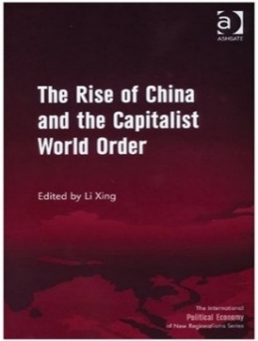
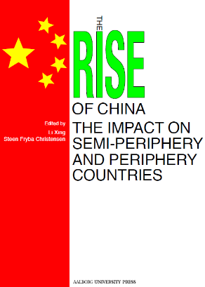
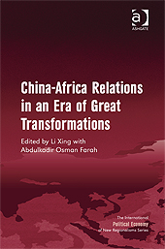
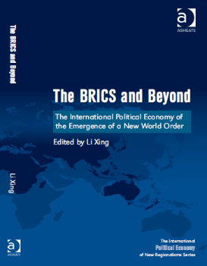
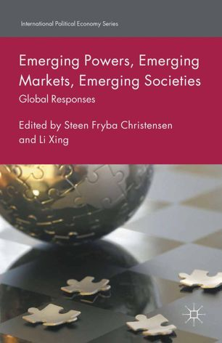
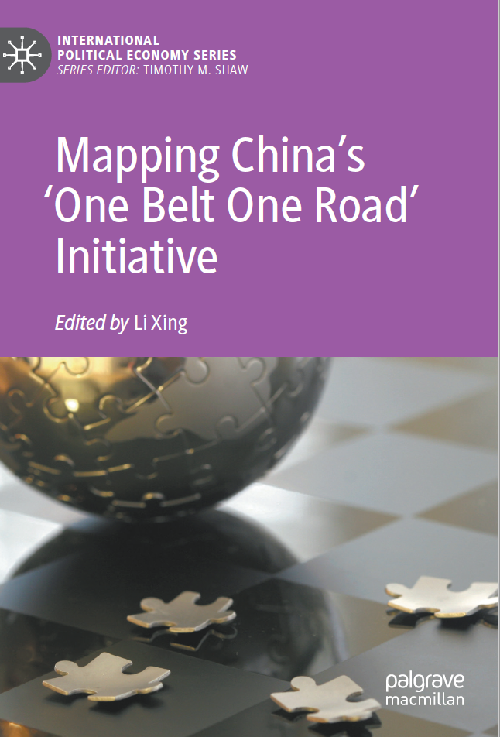
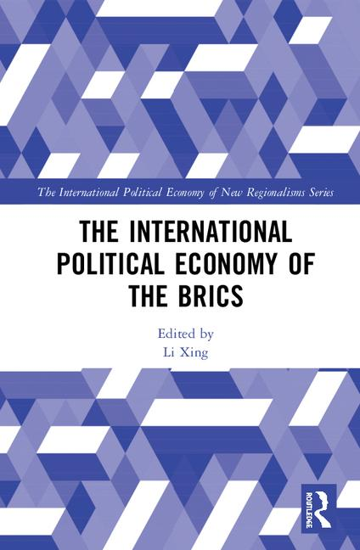
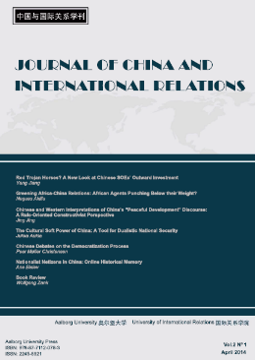
The International Political Economy of the BRICS
Li Xing
Professor/Director, Research Center on Development and International Relations
Editor-in-Chief, Journal of China and International Relations
Aalborg University
Denmark

Slide 2
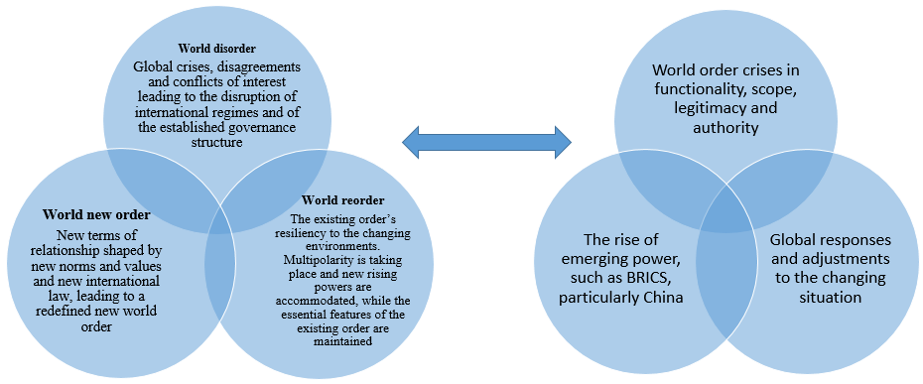
Three on-going processes
reflect

Slide 3

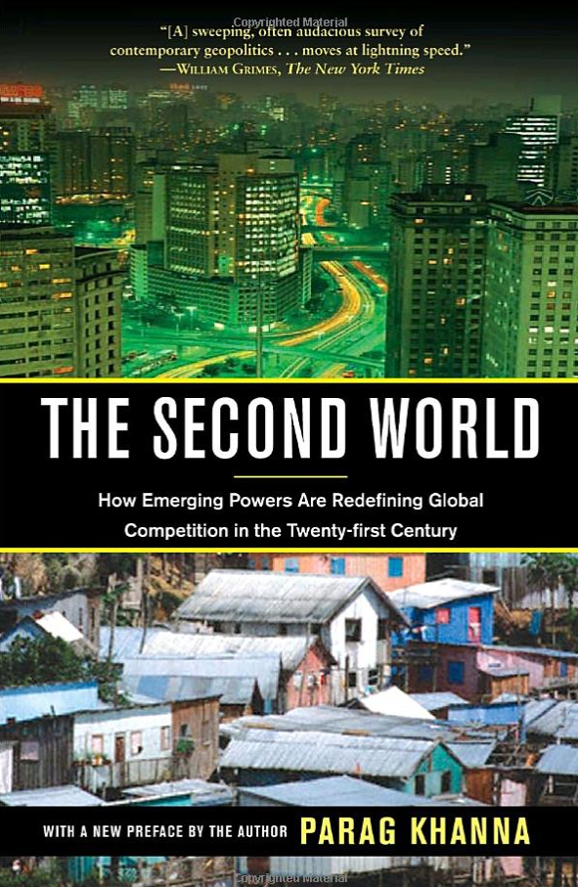
Concept – emerging power, rising power?
Emerging power
(market/state/society)
Ascent powers who are able to make a hierarchical transition to the core in international politics and economics
Semi-periphery states
Economic positioning in the capitalist world system
Second World
(excl. the G3)
Eastern Europe, Central Asia, South America, the Middle East, and East Asia growing in influence and economic strength
Intermediate states
self-created identity or ideology - Canada, Brazil, India, etc
multilateralism and institutions
The Big 3
BRICS?

Slide 4
Jim O’Neill focused his attention on four more emerging economies: Mexico, Indonesia, Nigeria and Turkey. (MINT group)
Economic approach
Emerging powers
Emerging state
Emerging market
Emerging society
Structural approach
IR
IPE
IPE
Social, cultural, historical approach, constructivism

Slide 5
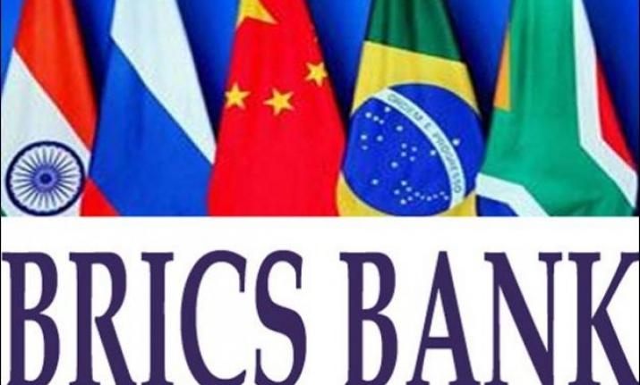
The historical evolution of the BRICS
The first phase (2001–2007)
“BRIC” (then without South Africa) stood for little more than an investment category invented by Goldman Sachs.
The second phase (2008–2014)
With the inclusion of South Africa, the world witnessed the emergence of the BRICS as a political platform, a largely informal nature.
The third phase (2015----)
It began the transition to a, marked by a process of institutionalization and the launch of the BRICS’ New Development Bank
Neo-Gramscian, cox

Slide 6
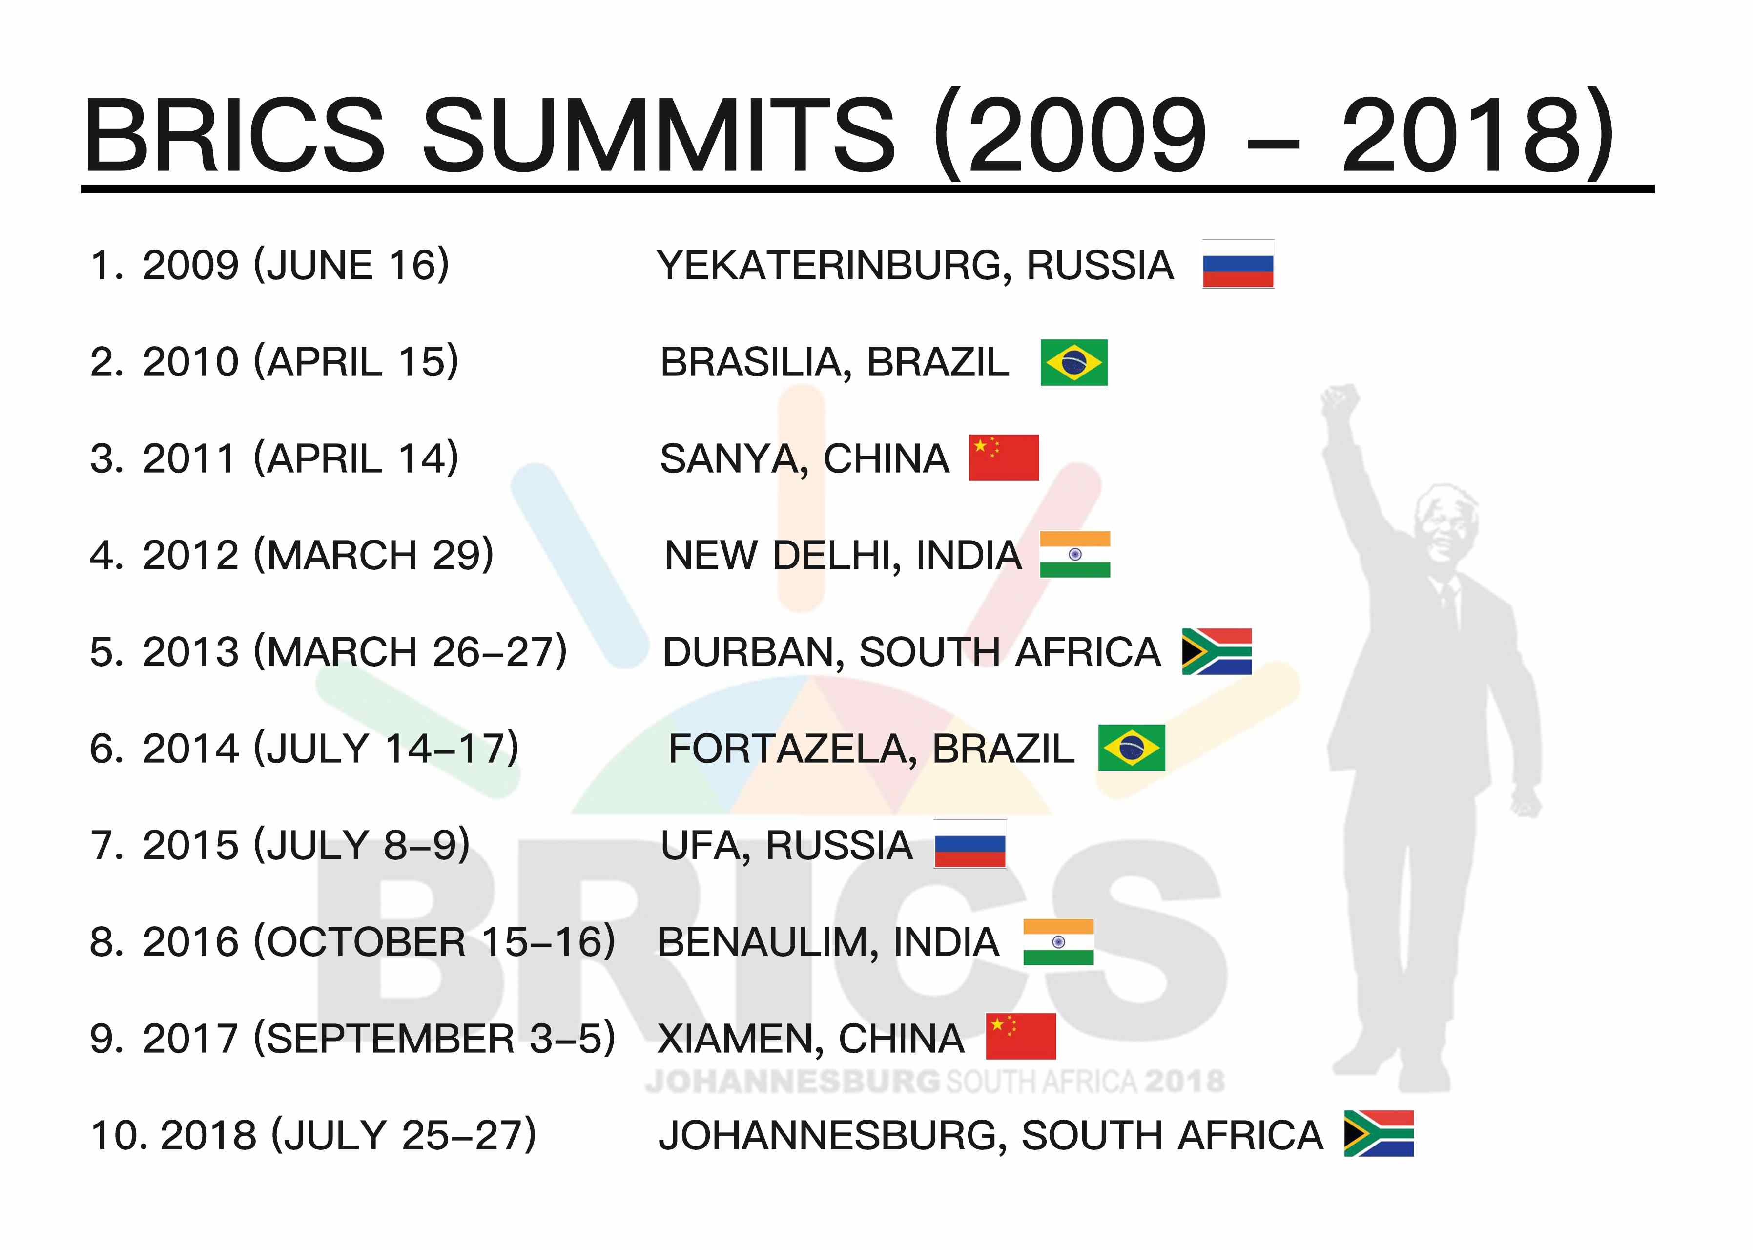
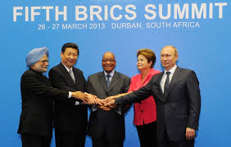
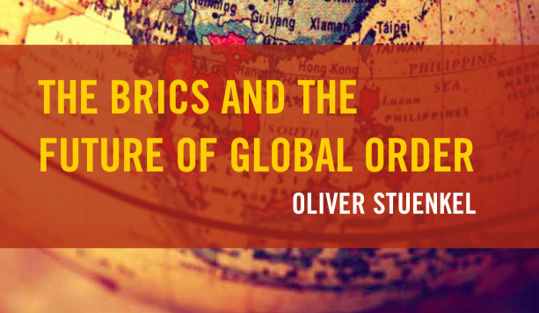

Slide 7
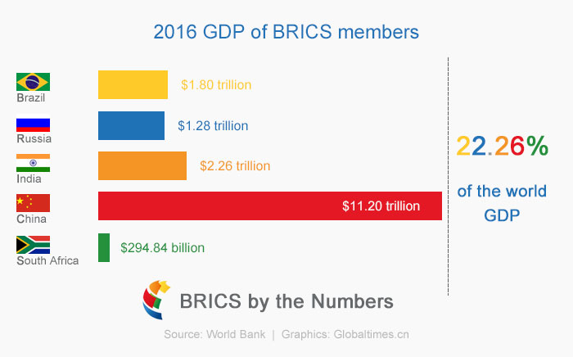
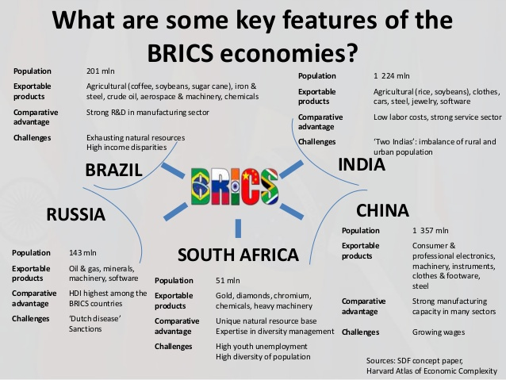
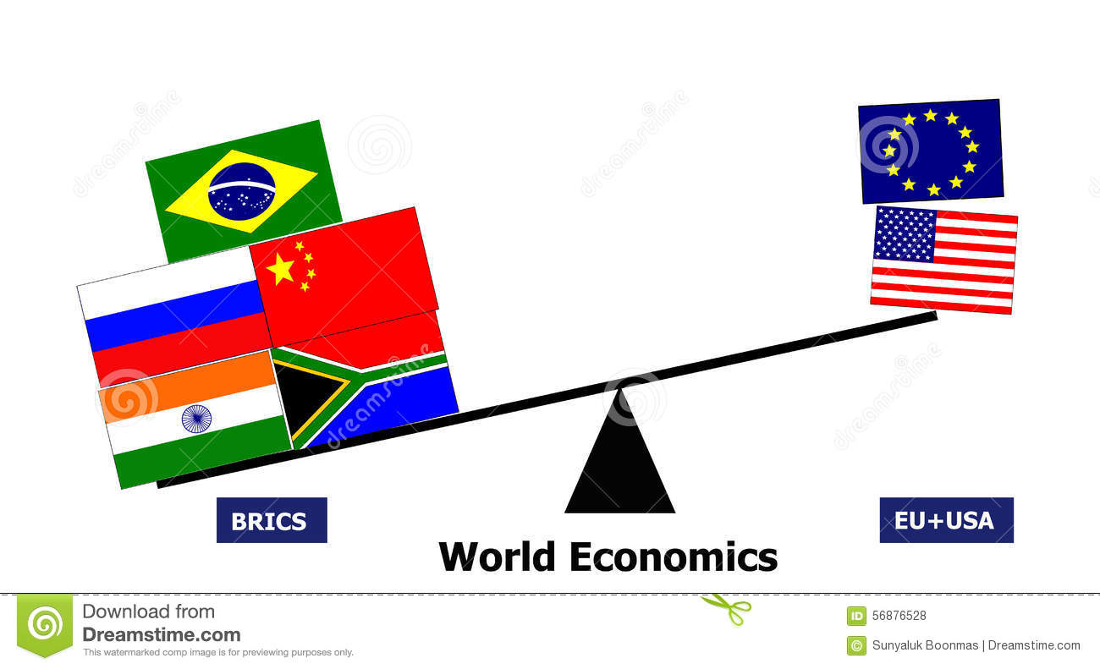
PPP

Slide 8
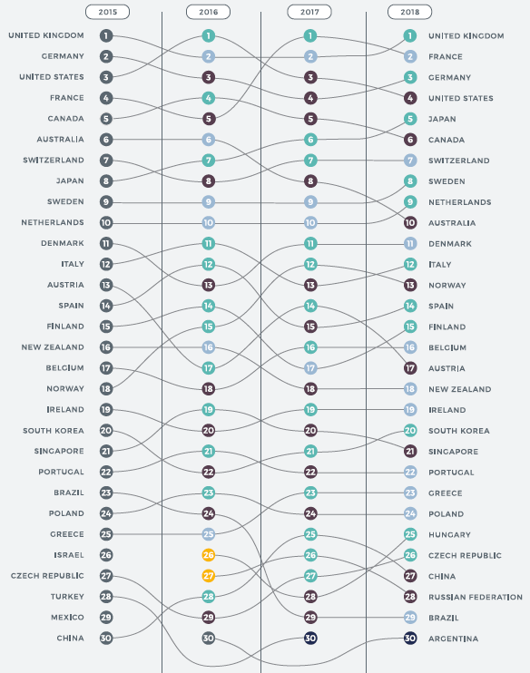
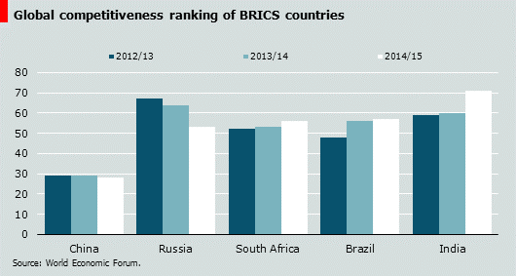
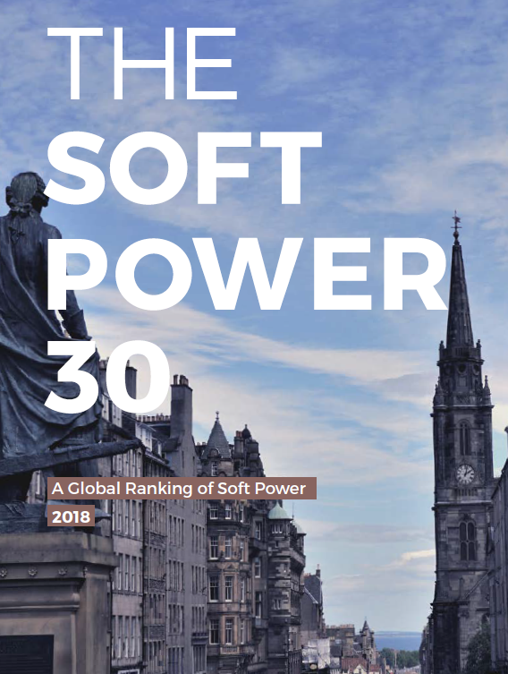
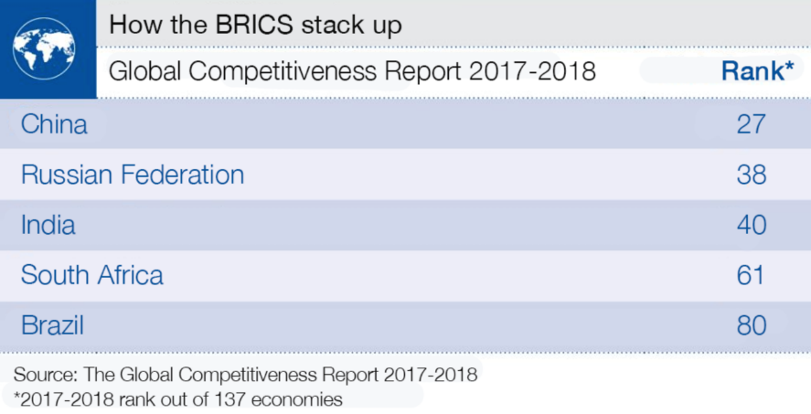
The BRICS competitiveness

Slide 9
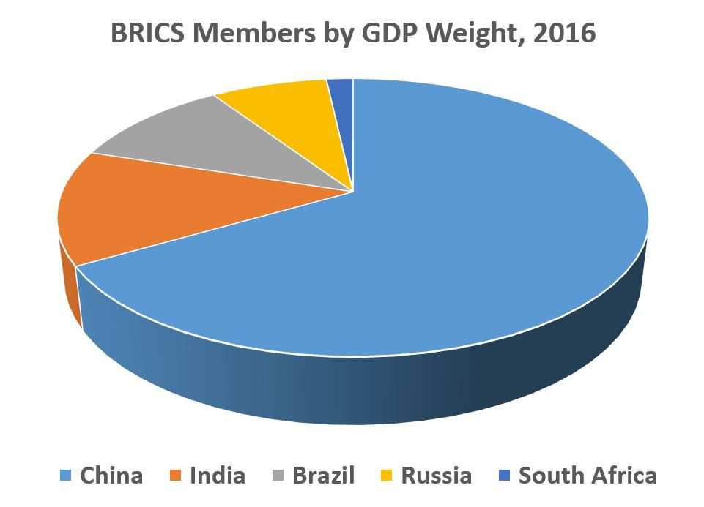
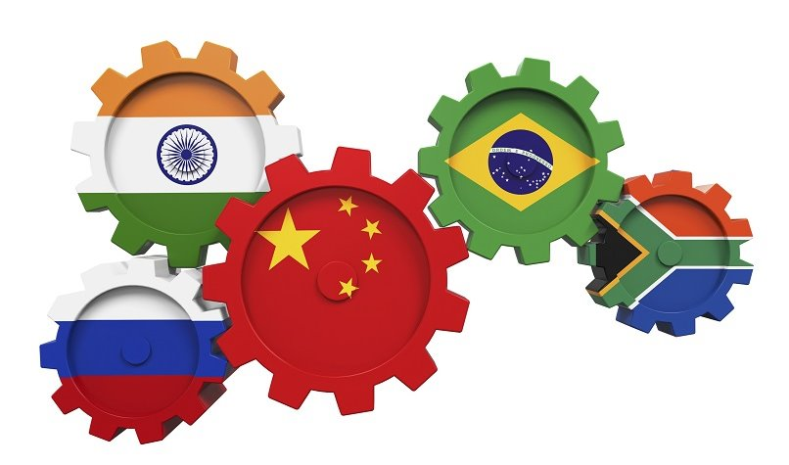
BRICS are not entirely equal powers
China alone accounts for 55% of BRICS’ GDP and 49% of their military spending
Take China out of the ‘BRICS’, and the ‘BRIS’ look much less powerful
BRICS much more a “China-with-partners” group than a union of equal members.

Slide 10
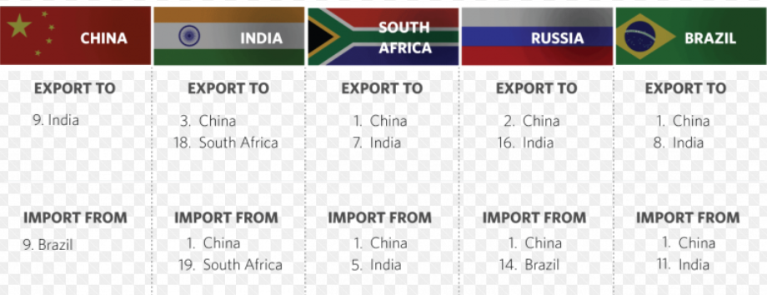
Intra-BRICS trading relationships

Slide 11
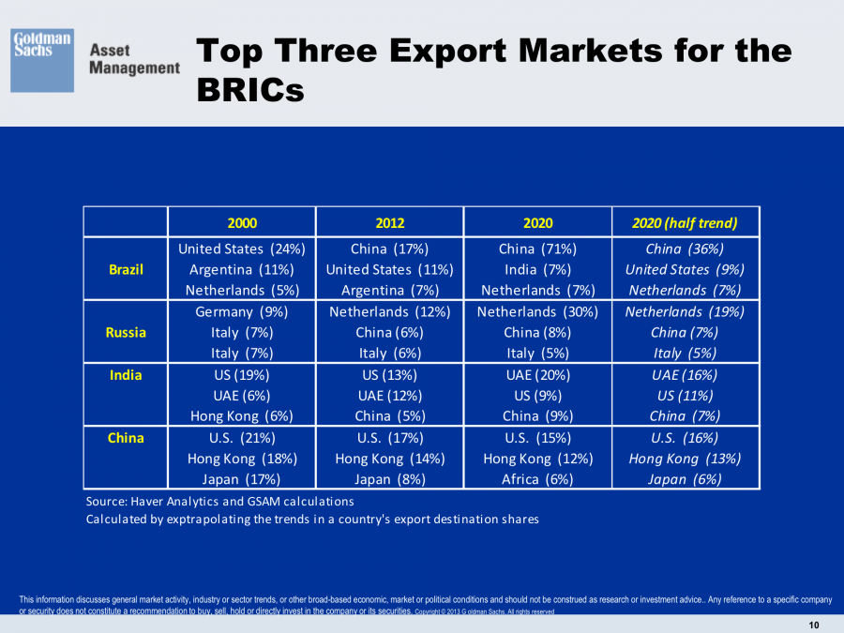
Apart from Russia, the BRICS countries are heavily integrated into consumer goods production with the ‘West’.

Slide 12
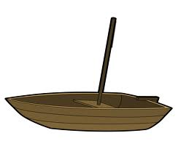
Emerging power standing on two boats
Internatonal trade
Intra-BRICS trad
Do not overemphasize their conflict
Do not overemphasize their alliance
With the existing order:
The driving force for globalization and transnational capitalism,
more economic relations with the existing core of the order,
The benefits from the existing order
Benefit from the system. Its success also challenges the fundamentals of the system
With the emerging powers:
Different dissatisfaction with some existing rules of games
Different antagonism against the 5 monopolies by the core
Bilateral problems
Not able to be a historical bloc
Political alliance, overcoming individual limit

Slide 13
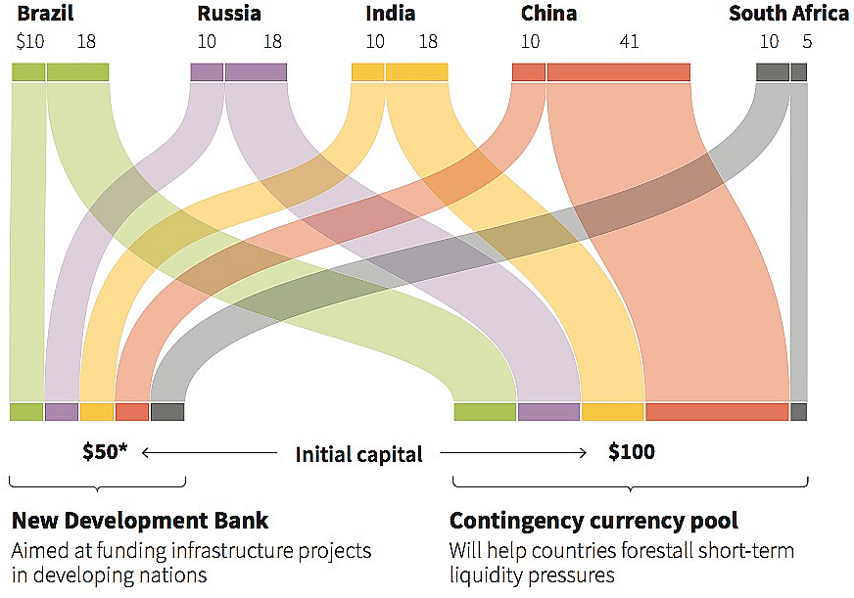
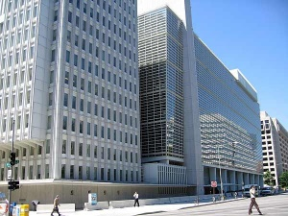
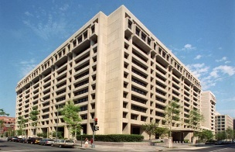

The BRICs has an explicit sense of alliance, not aiming at setting up an alternative financial order, but rather forming a counterbalance as a way to enhance multilateralism or avoid US hegemony and universalism.
World Bank
IMF
“new” world economic order?
It is not intended to “replace” of the role of global and regional development banks, such as the World Bank, the Asian Development Bank, the African Development Bank, the Latin American Development Bank and the European Development Bank

Slide 14
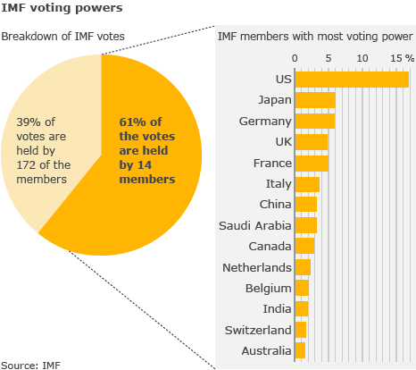
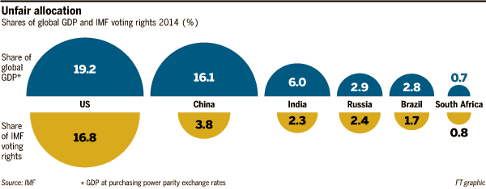
The BRICS/China and IMF power shift
As of 2017 the quota of China in the IMF was 30.5 billion SDRs, giving it 6.09% of the total vote
Voting is skewed towards the global north/ developed economies

Slide 15
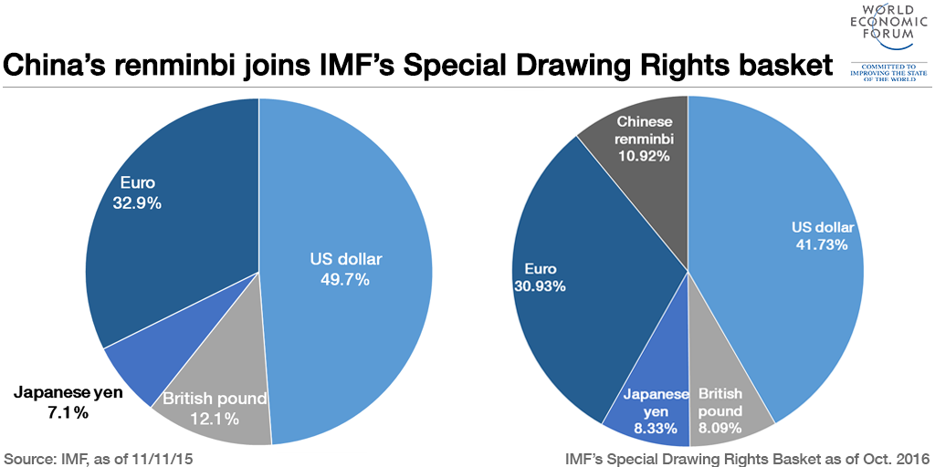
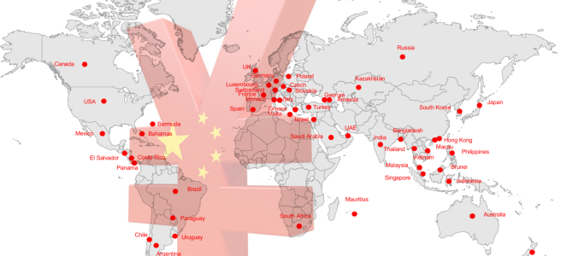
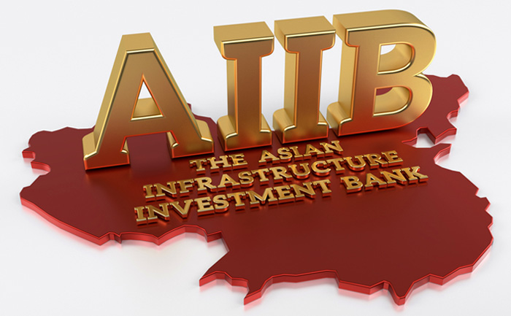
The emergence of China’s global financial order ?
Chinese normative principles, norm diffusion from AIIB:
1- Unconditionality
2- infrastructure
3- Asian developing countries voting power

Slide 16
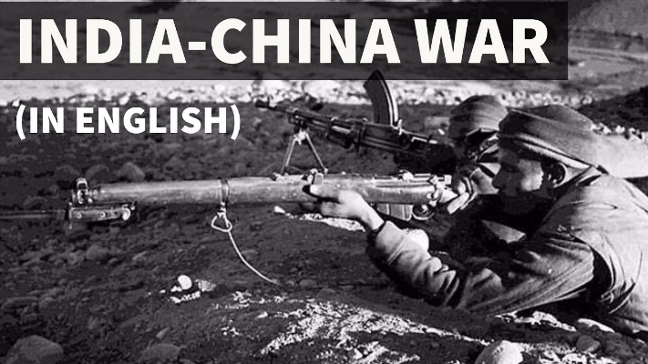
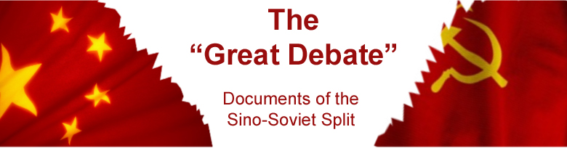
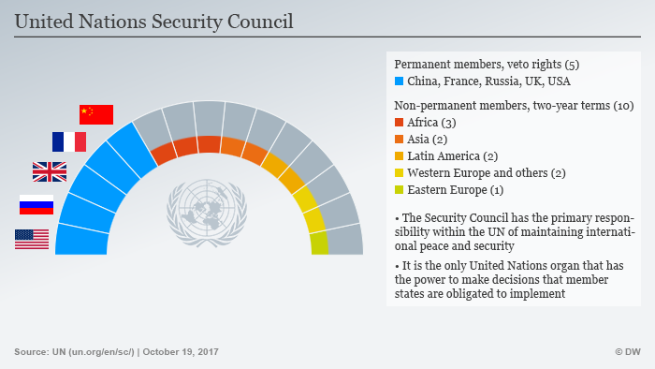
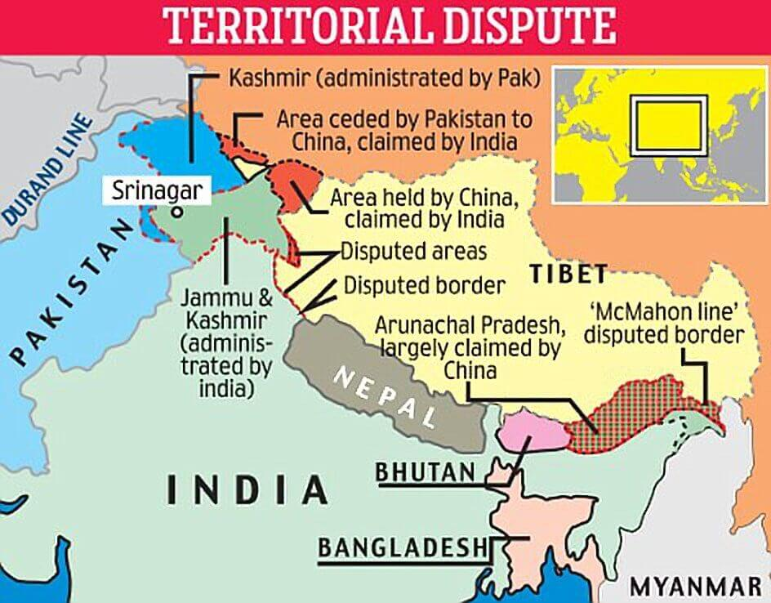
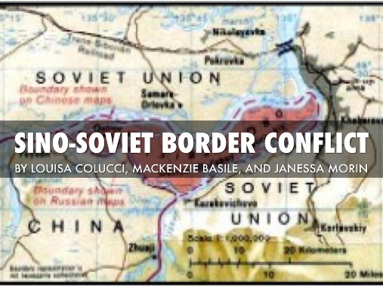
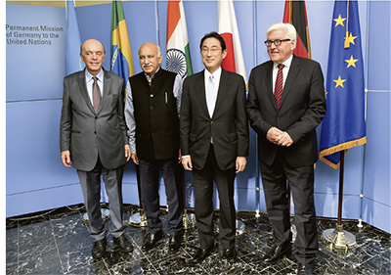
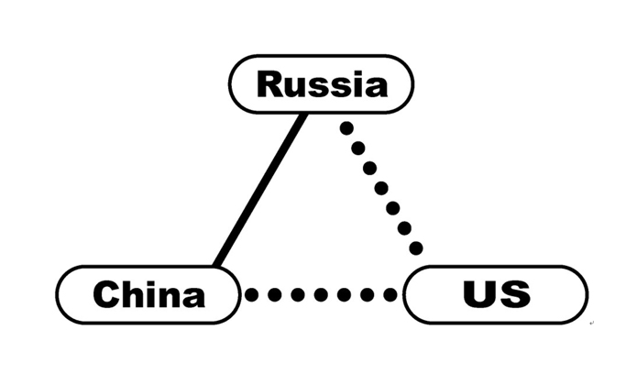
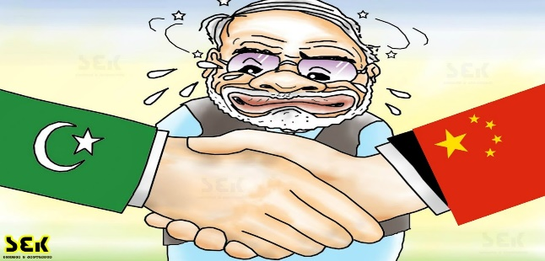
Intra-BRICS complications
India-China War 1962

Slide 17
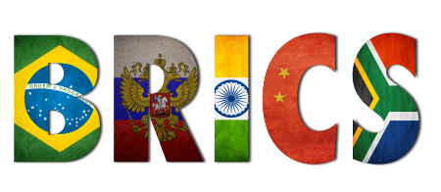

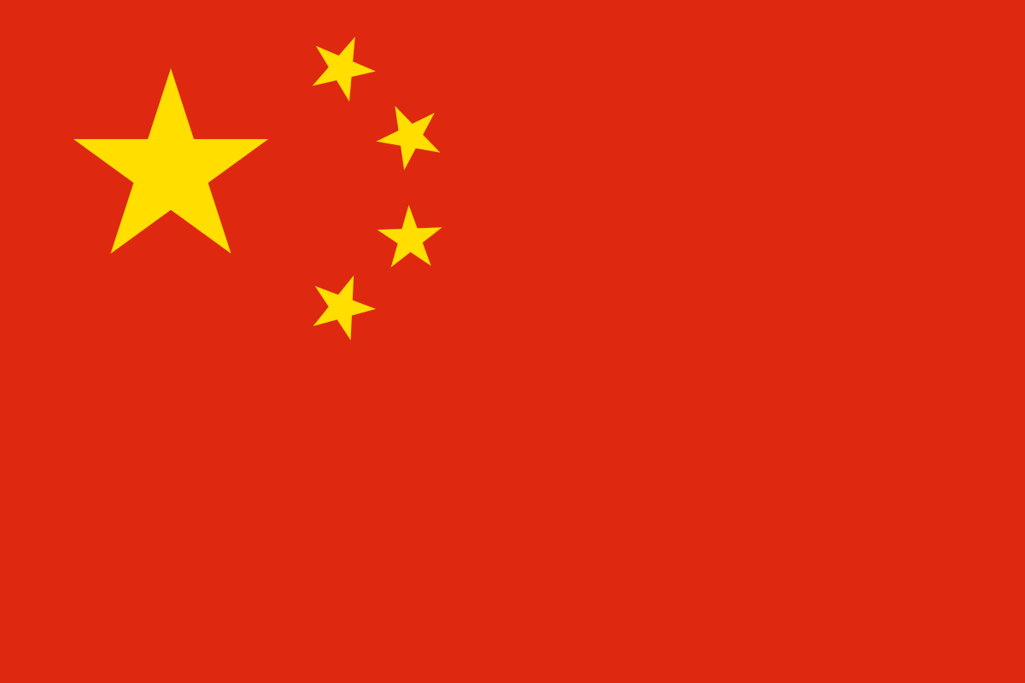
Theoretical reflections: BRICS or China
Realism (Power transition)
Liberal interpretation
Constructivism
World system theory
Neo-Gramscian hegemony
Independent hegemony
Kautsky-Lenin debate
How to understand the phenominon of the BRICS?
How to understand the interplay between the BRICS and vis-a-vis the existing principle powers?

Slide 18
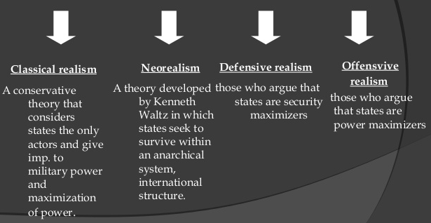
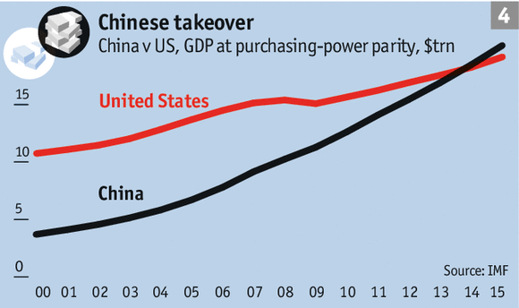
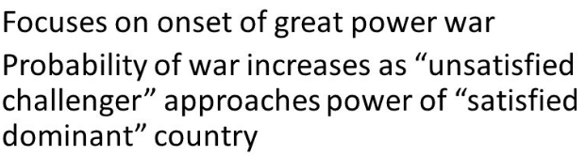

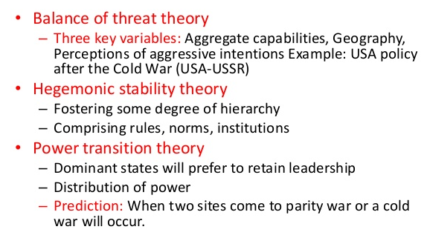
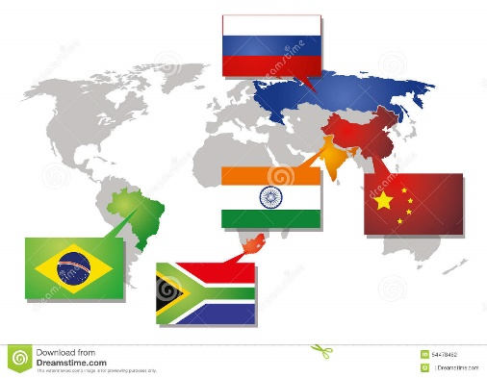
Realism (Power transition)
Reflecting a pessimistic view on power transition in the world order, Mearsheimer (2010), a proponent of realism, concludes that China’s rise will not be peaceful due to the high degree of uncertainty and distrust between the rising revisionist hegemon (China) and the existing defensive hegemon (the US).
Debate question on application:
BRICS or China ??

Slide 19
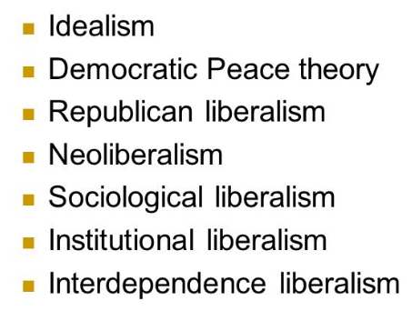
Liberalism, or Liberal hegemony
Liberalism tends to prioritize economics and other non-military factors as playing a more determining role in global governance. Liberal institutionalism, in particular, regards hegemony as being embedded in the interactions of each individual at the bottom, and in the norms and values of international institutions as rule-settlers at the top.
Liberal-minded scholars are generally less pessimistic toward power transition in a world order that is structured by a rule-based system with well-developed international institutions. Neoliberalism regards the neoliberal world order led by US hegemony as benign and globally beneficial. The neoliberal order can be characterized as an open, rule- and institution-based global system emphasizing norms of non-discrimination and market openness
Unit of analysis:
The BRICS ? Why the BRICS Bank??
Why the AIIB bank??
The individual countries, who?

Slide 20

Constructivism
Four common elements in all constructivist theories of IR: 1) international relations consist of ideas, values and norms and not only of material power and physical conditions; 2) common intersubjective beliefs and shared values between countries and people constitute the central ideological elements of the theory; 3) common creeds compose and express people’s interests and identities; and 4) the theory must ascertain the means in which these relations are formed and expressed.
BRICS, not a constitutive treaty, not IO
Rather, BRICS a “alliance”
Constituent
Institution
Structure
(hard)
Ideation,
Norm and
value
(soft)
There is a BRICS creed --- global forums and institutions need to be more democratic
Debate question on application:
BRICS or China?? Or both ??
World order
China’s rise: symbolic power and norm diffusion

Slide 21
World system theory
for capital to be shifted away from the declining sectors into the rising sectors, the declining sectors need to be relocated from the core to the semi-periphery (or to the periphery according to the labour condition and the technological level). Some countries in the latter two categories will benefit from such global production and capital relocation.
World system theory
Cyclical rhythms (constradictions and crises
Rise and fall of guarantors
Continuous structural shifts
Division and re-division
Foreign Direct Investment (FDI)
Global outsourcing
Upward mobility
Room for maneuver
Join regional/global division of labour
Debate question on application:
BRICS or China ??

Slide 22
Conceptual lens - Hegemony
Emerging powers and the BRICS
hegemony
Realism
hegemony as the dominance by one leading state in interstate relations
“hegemonic stability”.
“power transition theory”
Counter-hegemony
Liberalism
hegemony as being embedded in the interactions of each individual at the bottom, and in the norms and values of international institutions as rule-settlers at the top
A byproduct of the existing system
Constructivism
the dual construct of both their material weight and their symbolic value, a shared creed in their transformative potential to make changes in world order in general and global institutions in particular
World system theory/Marxist critical school
hegemony emphasizes state-based class and material forms of a hegemony which is shaped and maintained by a global division of labor that constantly generates and regenerates unequal exchange.
Capitalist class as the focus of unit of analysis
Value, norm change
Cyclical development
Rising power with its own mode of governance
threat
cooperation

Slide 23


Neo-Gramscian IR teory
China
Debate question on application:
BRICS or China ??

Slide 24
Interdependent Hegemony
System of norms and values
Mode of production, competition, accumulation
Global governance
(UN, IMF, WB)
Political and econmic influence in regions and states
Cultural and ideological leadership (education and media)
Material capacities (structural powers and monopolies)
Control of the structure of finance and credit
The world is witnessing neither the repeat of history manifested by world wars nor the harmonious integration and accommodation of the late-comers into the established power system.
The international political economy has entered into an age of “Interdependent” or “intertwined hegemony”, which implies that the sources to feed and maintain the areas of structural power and monopoly are no longer dominated exclusively by the US/West, and to a large extent they are dependent on the inputs from emerging powers.

Slide 25
Interdependent hegemony characteristics in world reordering
Interdependent
hegemony
“national interest” in terms of cost-benefit analysis rather than in terms of political and ideological alliance
alliances are more issue-based rather than norm-based
collective “positioning” strategy and “balancing” tactic. Not a historical bloc
no hegemonic norms and values defined by one single countries
“incipient hegemony” vs declining hegemony
reverse the traditional dependent relationship: first world and third world
The BRICS is a good example

Slide 26






Kautsky-Lenin debate
Core states form a “cartel” in order to maintain their export markets and super-exploitation
importance of coalition and cooperation
jointly exploit the underdeveloped world
The rise of financial capitalism
Matured internal market, overproduction let to capital overseas expansion.
core of capitalism competed to expand their exploitative sphere, their interests intersected and conflicted, leading to inevitable wars
neocolonialism
Neoimperialism
Credit imperialism
Inter-capital conflict

Slide 27

China’s multiple positions: hegemony and counter-hegemony
Neo-dependency
Made in China model
Made in China 2025
Belt and Road
De-industrialization in the South
De-industrialization in the North
Implication to the BRICS??

Slide 28

Conclusion: Hegemony and counter-hegemony two sides of the same coin
The Existing world order/world capitalist system
Emerging power/BRICS, China
BRICS/China’s success are achieved within the existing capitalist world order.
BRICS/China have more and deeper economic relationships with the existing world powers than with each other.
At the same time, their success is also challenging many “enduring aspects” and “global arrangement” of the existing world order, while the order’s law of value also shapes their action.
BRICS/China have different antagonisms/dissatisfactions with the existing order, and among themselves.
BRICS/China are far more diversified among themselves politically, economically and culturally than the West as a block. There are asymmetrical power relations both within themselves with the outside world.
BRICS/China is not providing an alternative hegemony with universal norms and values, but lead the world into interdependent hegemony.

